Slide 1



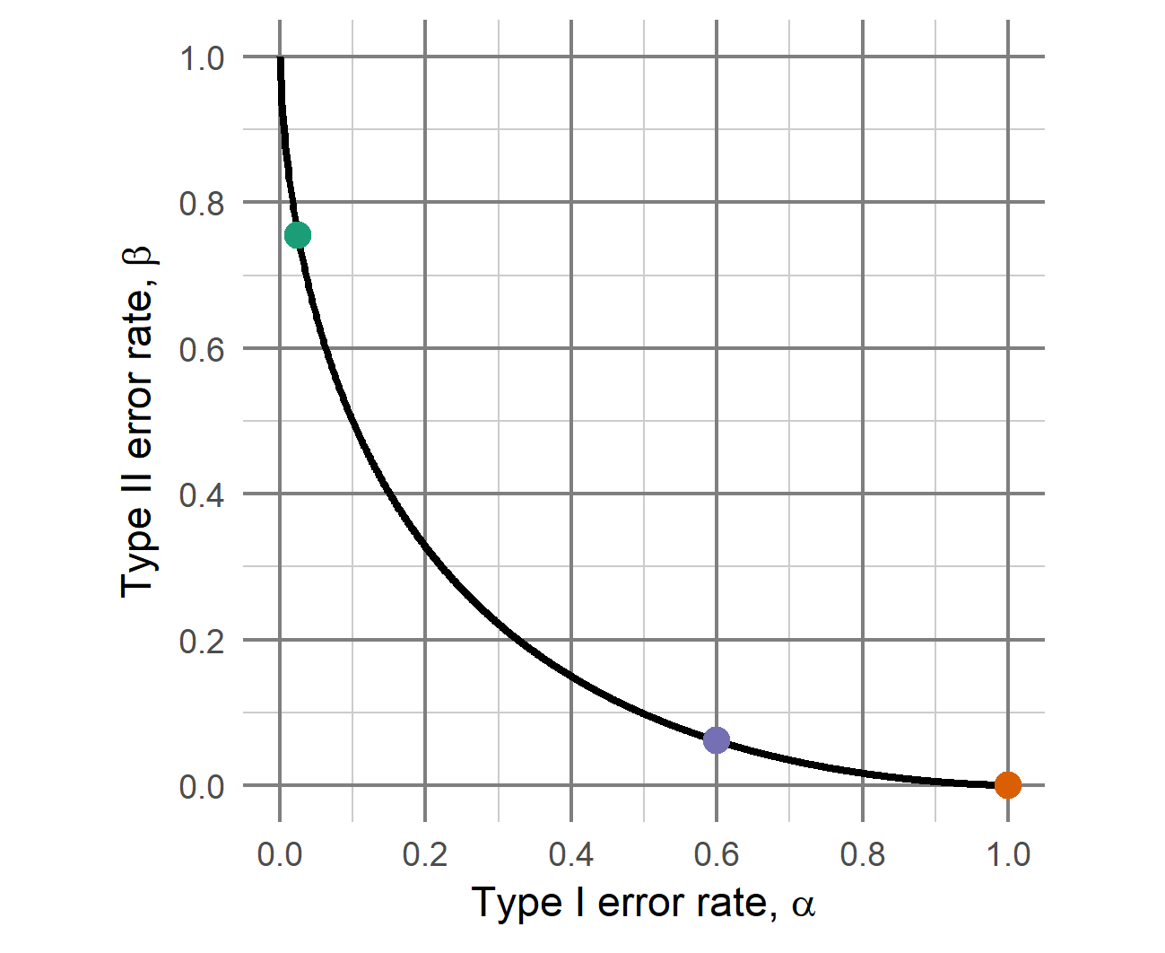
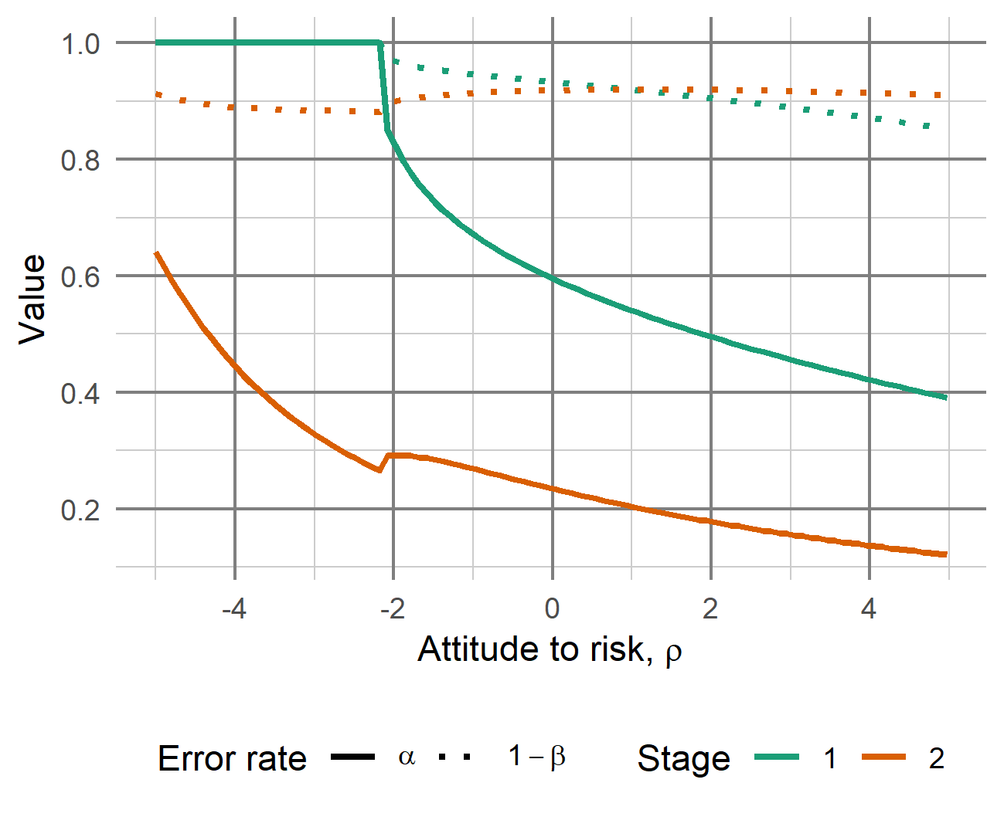



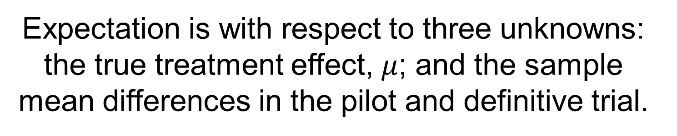
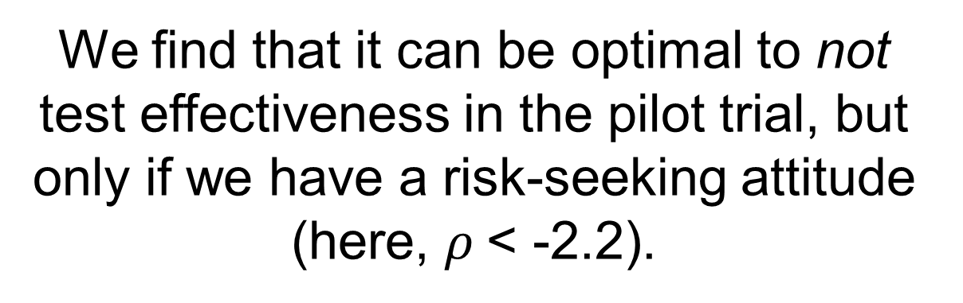

Optimising hypothesis tests of efficacy in external pilot trials using Bayesian statistical decision theory
Duncan T. Wilson*, Rebecca E. A. Walwyn, Julia Brown, Amanda J. Farrin
Leeds Institute of Clinical Trials Research, University of Leeds
* @DTWilson, d.t.Wilson@leeds.ac.uk, https://github.com/DTWilson
Motivation
Problem
Many large complex intervention RCT’s give statistically insignificant results. Could pilot trials help to identify ineffective interventions early on?
We don’t usually assess effectiveness in pilots because their small sample size would lead to low power, assuming a conventional type I error rate is used…
Should we test for effectiveness in pilot trials, and if so, how can we determine optimal error rates?
We consider scenarios where both the pilot and definitive trials are two-arm parallel group designs with a normally distributed primary endpoint with known variance.
At each stage, a frequentist hypothesis test of effectiveness will be conducted.
At the first stage, a positive result in the pilot means the definitive trial will go ahead.
At the second stage, a positive result in the definitive trial means the intervention will be adopted; otherwise the control will remain the standard treatment.
The design problem is to choose the type I and II error rates of both the pilot and definitive trials.
…but not testing at all is equivalent to testing with a type I error rate of 1.
This extreme balancing of error rates in favour of minimising type II errors will rarely be optimal – for example, we could reduce type I error from 1 to 0.6 while maintaining a high power of 0.94.
Methods
We search over all possible programme designs to find that with largest expected utility.
Expectation is with respect to three unknowns: the true treatment effect, $μ$; and the sample mean differences in the pilot and definitive trial.
Three attributes which influence our decisions: d, the change in the primary endpoint; n, the total sample size; and C, the treatment costs of the intervention.
$$\max_{(α_{1}, β_{1}, α_{2}, β_{2})}{E_{μ, x_{1},x_{2}}\left[1 − e^{−ρ\left(k_{d}d+k_{n}n+k_{c}C\right)}\right]}$$
Programmes are defined by error rates at stage 1 (pilot) and stage 2 (definitive trial)
We use a normal prior distribution for the unknown treatment effect, $μ$.
Attitude to risk: 0 implies risk-neutral, positive implies risk-averse, and negative risk-seeking.
Scaling parameters, summing to 1, which reflect acceptable trade-offs between the three attributes.
Results
Conclusions
For a fixed choice of scaling parameters, we examined how optimal programme designs vary with the attitude to risk.
We find that it can be optimal to not test effectiveness in the pilot trial, but only if we have a risk-seeking attitude (here, $ρ$< -2.2).
We have shown how Bayesian statistical decision theory can be used to determine optimal designs of pilot-then-definitive trial programmes evaluating complex interventions.
We found that it can be optimal to not test effectiveness in the pilot trial, but only when we are risk-seeking.
To use Bayesian statistical decision theory, we require both a prior distribution and a utility function to be specified. The elicitation of these may be challenging in practice.
We have focused on the case of an external pilot with a normally distributed primary endpoint with known variance. Extensions to internal pilots, binary endpoints, and unknown variance are all possible.
A moderately risk-averse attitude ($ρ$ = 2) gives an optimal design of:
Pilot trial:
$n_{1}=32, α_{1}=0.49, {1 − β}_{1}=0.9$
Definitive trial:
$$n_{2}=98, α_{2}=0.18, 1−β_{2}=0.92$$
← Risk-seeking
Risk-neutral
Risk-averse →
More details, including all R code used to generate the results in this poster, can be found at https://github.com/DTWilson/Opt_pilot_ocs
This work was supported by the Medical Research Council [grant number MR/N015444/1].

